Slide 1

Capital Structure
Financial Management(HS4L003)
Dr. Naresh Chandra Sahu
Associate Professor (Economics)
School of Humanities, Social Sciences & Management
Indian Institute of Technology, Bhubaneswar

Slide 2


Learning Outcomes
Understand the concept and components of capital structure (debt, equity).
Explain the importance of capital structure in financial decision-making.
Describe major capital structure theories: NI, NOI, Traditional, MM Proposition.
Compare assumptions and implications of different capital structure theories.
Analyse how capital structure affects firm value and cost of capital.

Slide 3
Is it safer for a company to use only equity or only debt? Why?

Slide 4
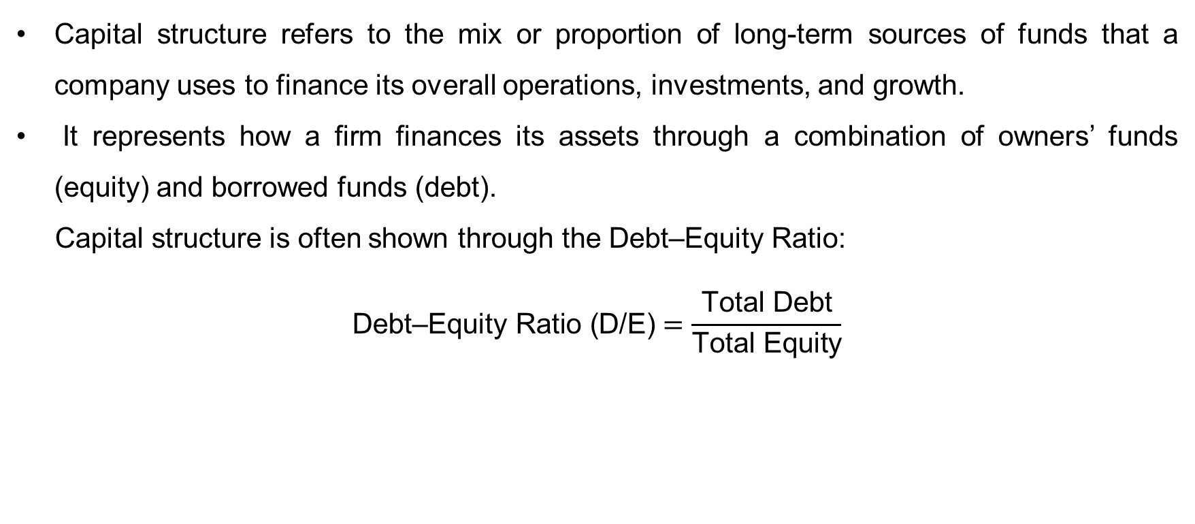
What is Capital structure?
Capital structure refers to the mix or proportion of long-term sources of funds that a company uses to finance its overall operations, investments, and growth.
It represents how a firm finances its assets through a combination of owners’ funds (equity) and borrowed funds (debt).
Capital structure is often shown through the Debt–Equity Ratio:
$$\text{Debt}\text{–}\text{Equity} \text{Ratio}\text{ (}\text{D}\text{/}\text{E}\text{)}=\frac{\text{Total} \text{Debt}}{\text{Total} \text{Equity}}$$

Slide 5
Objectives of Capital Structure
It helps minimize the overall cost of capital.
It ensures flexibility in raising future funds.
It allows management to retain control of the company.
It improves the creditworthiness of the firm.
It enhances profitability for shareholders through leverage.
It ensures the long-term stability and survival of the firm.
It promotes optimum utilization of financial resources.
It builds investor and stakeholder confidence.
It supports business growth and future expansion.

Slide 6
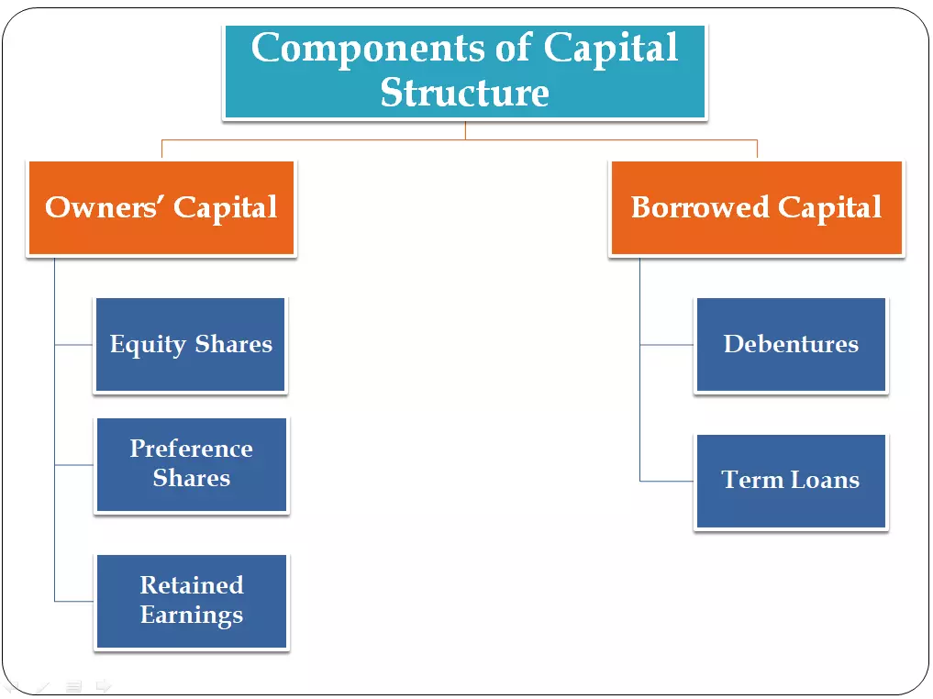
Components of Capital Structure

Slide 7
Factors Affecting Capital structure
Nature of Business – Stable businesses can handle more debt; risky businesses rely on equity.
Business Risk – High business risk discourages debt; low risk allows higher debt.
Profitability – Profitable firms can use retained earnings; less profitable firms need external financing.
Cash Flow Position – Stable cash flows support more debt; irregular cash flows favor equity.
Cost of Capital – Firms aim to minimise overall financing costs by balancing debt and equity.
Control Considerations – Debt preserves ownership control; equity may dilute control.
Growth & Expansion Plans – Aggressive growth requires more financing.

Slide 8
Theories of Capital Structure
Net Income Approach
Net Operating Income Approach
Traditional Approach
Modigliani and Miller Theory

Slide 9
Theories of Capital Structure
Net Income Approach
The Net Income Approach was proposed by David Durand.
It explains how a company’s mix of debt and equity affects its overall cost of capital and firm value.
Assumptions:
Cost of debt (Kd) and cost of equity (Ke) remain constant.
There are no taxes.
The risk level of the firm does not change with more debt.
Debt (D) is cheaper than equity, because lenders require a fixed interest, while shareholders expect higher returns.
It suggests that a firm can increase its total value by using more debt in its capital structure.

Slide 10

Theories of Capital Structure
If
D then Cost of capital
Market value of share
Value of firm
and if
D then Cost of capital
Market value of share
Value of firm

Slide 11

Theories of Capital Structure
Net Operating Income Approach
The NOI Approach, also proposed by David Durand, gives an opposite view to the Net Income (NI) Approach.
Assumptions:
The overall cost of capital (Ko) remains constant.
The firm’s value depends only on EBIT, not on the debt-equity mix.
No corporate taxes.
Business risk remains unchanged.
Investors and firms borrow at the same rate.

Slide 12
Theories of Capital Structure
It states that the capital structure (mix of debt and equity) does not affect the total value of the firm or the overall cost of capital (WACC).
Whether the firm uses more debt or more equity, the total value remains constant.
This happens because when the firm increases its debt, equity holders demand higher returns due to increased financial risk — balancing out any benefit from cheap debt.

Slide 13
Theories of Capital Structure
The Traditional Approach
The Traditional Approach is a compromise between the Net Income (NI) and Net Operating Income (NOI) approaches.
It suggests that there is an optimal capital structure, a right mix of debt and equity, that minimises the overall cost of capital (WACC) and maximises the firm’s value.
In the beginning, using debt is beneficial because debt is cheaper than equity.
However, after a certain point, too much debt increases financial risk, which increases the cost of equity and overall WACC.

Slide 14
Theories of Capital Structure
Phases of the Traditional Approach
Stage I – Increasing Debt is Beneficial
Small use of debt → overall cost of capital decreases.
Reason: debt is cheaper and interest is fixed.
Stage II – Optimum Capital Structure
The lowest point of the WACC curve.
This mix of debt and equity gives maximum firm value and minimum cost of capital.
Stage III – Excessive Debt Becomes Risky
More debt increases financial risk → shareholders demand higher returns → cost of equity rises.
As a result, WACC increases → firm value decreases.

Slide 15
Theories of Capital Structure
Modigliani and Miller (MM) Theory
The Modigliani and Miller Theory (1958) is one of the most important theories of capital structure. It was developed by Franco Modigliani and Merton H. Miller.
Assumptions:
No transaction costs or bankruptcy costs.
Firms and investors can borrow at the same rate.
No taxes (in the first model).
Perfect capital market – all investors have the same information.
Risk of business is constant.
This theory explains the relationship between capital structure, cost of capital, and firm value under two conditions
1. Without Taxes
2. With Corporate Taxes

Slide 16
Theories of Capital Structure
1. MM Theory Without Taxes
The value of a firm is independent of its capital structure.
Whether a firm uses debt or equity, the total value remains the same.
The cost of equity (Ke) rises with more debt because shareholders demand higher returns for increased financial risk.
This rise in Ke (cost of equity) exactly offsets the benefit of cheap debt → so WACC (overall cost) remains constant.
Therefore, capital structure does not affect firm value.

Slide 17
Theories of Capital Structure
2. MM Theory With Taxes
When corporate taxes are introduced, interest on debt becomes tax-deductible.
This creates a tax shield benefit, reducing the effective cost of debt.
As a result, using more debt increases firm value.
Hence, under taxes: More Debt → More Tax Savings → Higher Firm Value

Slide 18
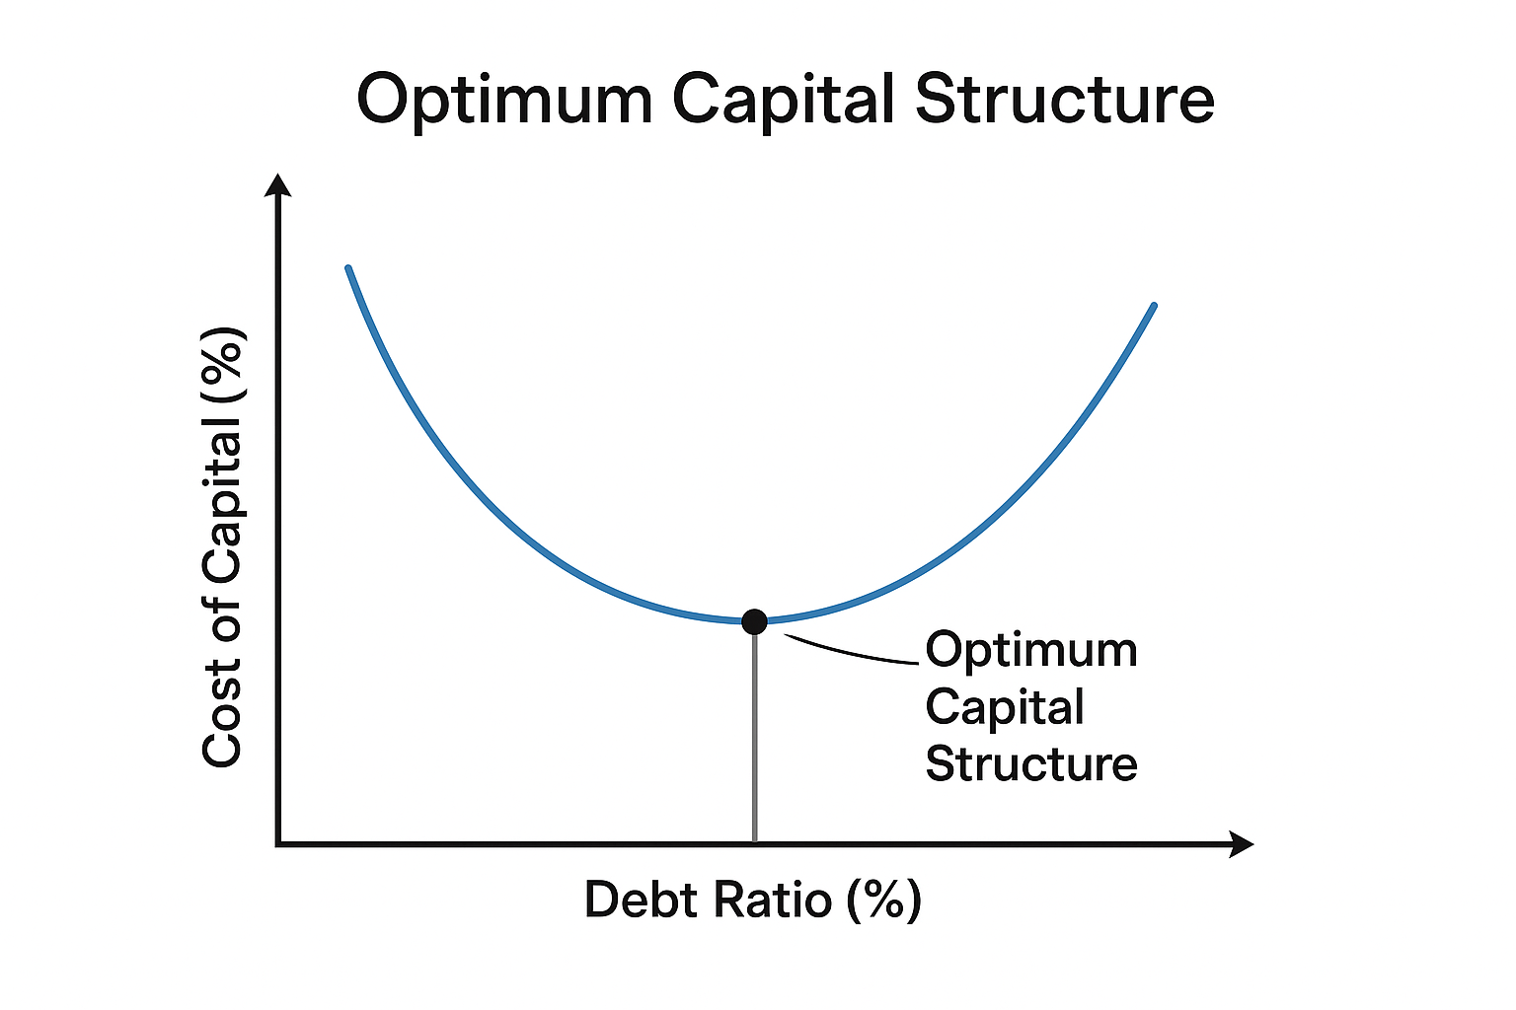
Optimum Capital Structure
The Optimum Capital Structure is the best possible combination of debt and equity that maximises the value of the firm and minimises the overall cost of capital (WACC).
It is the balance point where the benefit of using cheap debt is exactly equal to the increase in financial risk.
Beyond this point, taking more debt will increase financial risk and raise the cost of capital, thereby reducing firm value.

Slide 19
Optimum Capital Structure
Characteristics of Optimum Capital Structure
Lowest Overall Cost of Capital (WACC)
The mix of debt and equity results in the minimum possible cost of funds.
Maximum Firm Value
Market value of shares and the firm’s total value are highest at this point.
Balance Between Risk and Return
The firm uses enough debt to gain tax advantages, but not so much that it increases bankruptcy risk.
Financial Flexibility
The structure allows the company to raise funds easily when needed without creating an excess burden.

Slide 20
THANK YOU

